Slide 1

BSBTWK502
Manage team effectiveness

Slide 2
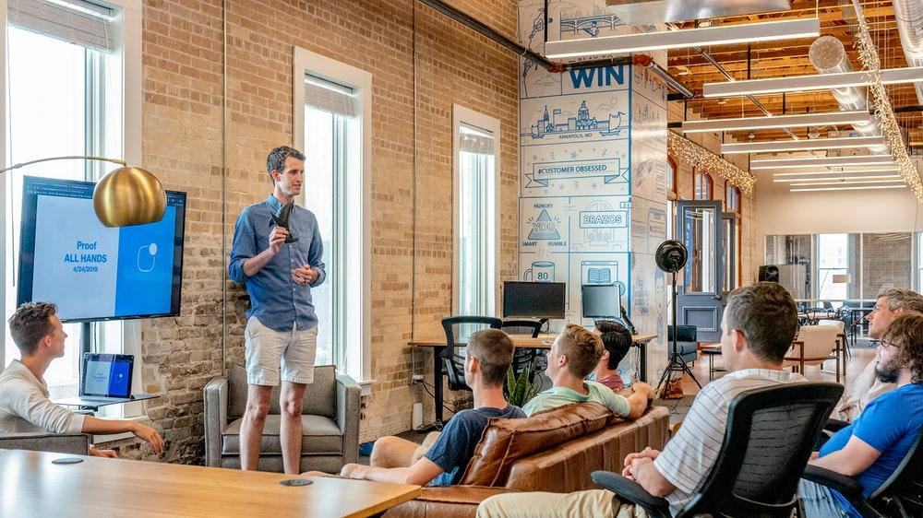
‹#›
Topic 1: Establish team performance plan
2021 Milestones International College

Slide 3
‹#›
Goal setting is one of the first steps in reaching performance expectations set by an organisation.
A team needs goals and clear objectives so that performance and achievements can be tracked.
Topic 1: Establish team performance plan
Topic 1: Insert topic title
© 2021 Milestones International College

Slide 4

‹#›
ACTIVITY: GROUP WORK
Work in your teams:
Research a few examples of business plans, look at the headings used to identify the primary purpose of the plan. Find one plan that the team thinks is the best example, and each keeps a copy for future reference.
Explore how team performance plans link to overall business objectives.
Topic 1: Establish team performance plan
© 2021 Milestones International College

Slide 5
‹#›
TEAM PERFORMANCE PLANS
A team performance plan is a detailed plan that specifies team goals and objectives, as well as actions to achieve these, responsibilities, timelines for achieving actions and performance indicators that will be used to measure performance.
Topic 1: Establish team performance plan
Topic 1: Insert topic title
2021 Milestones International College

Slide 6
‹#›
ACTIVITY: READ
Review information about team performance plans at:
http://www.crowe-associates.co.uk/teams-and-groups/team-plans/
Take any notes to summarise what you have read and keep for future reference.
Topic 1: Establish team performance plan
2021 Milestones International College

Slide 7
‹#›
TEAM PLAYERS
Teams will consist of people with particular strengths and weaknesses. Team members vary in the role that they play for example some could be practical and organised whereas others could be a good communicators or problem.
Topic 1: Establish team performance plan
Topic 1: Insert topic title
2021 Milestones International College

Slide 8
‹#›
ACTIVITY: RESEARCH AND DISCUSS
Using the Internet, search for your ideal career or job position. Read the job description – did it match your expectations of the desired role? Make notes.
Topic 1: Establish team performance plan
2021 Milestones International College

Slide 9
‹#›
BELBIN TEST
Several different theories have been developed, which categorise the different types of roles and personalities people display.
The Belbin test was designed to identify the different types of roles team members prefer precisely.
Topic 1: Establish team performance plan
Topic 1: Insert topic title
2021 Milestones International College

Slide 10
‹#›
ACTIVITY: RESEARCH AND DISCUSS
Visit the Belbin website to view the explanations for each role.
Research the various roles that team members take on. Which role are you likely to be? Which role do you have in your current class team? Is it the same role?
Topic 1: Establish team performance plan
2021 Milestones International College

Slide 11
‹#›
ACTIVITY: REFLECT
Complete the following quiz, which will help you to identify what type of role your personality suits:
http://testyourself.psychtests.com/testid/3113
Is this the same role that you specified earlier?
Topic 1: Establish team performance plan
2021 Milestones International College

Slide 12
‹#›
SUPPORTING TEAM MEMBERS
By supporting the members of your team, a manager can ensure that goals are met.
Topic 1: Establish team performance plan
Topic 1: Insert topic title
2021 Milestones International College

Slide 13
‹#›
ACTIVITY: RESEARCH AND DISCUSS
In small groups, think about the rewards and recognitions that you may have received in the past that they have found most beneficial. This could be either in a work or non-work-related context.
Brainstorm ideas and create a list as a group.
Topic 1: Establish team performance plan
2021 Milestones International College

Slide 14
‹#›
TEAM PERFORMANCE AND KEY PERFORMANCE INDICATORS
As indicated previously, the team performance plan should include key performance indicators that can then be used to measure performance.
The purpose of a KPI is to provide an objective performance measure is a crucial activity.
Topic 1: Establish team performance plan
Topic 1: Insert topic title
2021 Milestones International College

Slide 15
‹#›
ACTIVITY: READ
Read more about KPIs for teams at:
https://www.projectmanager.com/training/8-essential-kpi-metrics-teams
Take any notes to summarise what you have read and keep for future reference.
Topic 1: Establish team performance plan
2021 Milestones International College

Slide 16
‹#›
ACTIVITY: GROUP WORK
Work in a group of four.
Research the job descriptions of an event coordinator, marketing person, office administrator, and marketing manager. Study their position descriptions and use the information to build a team performance plan for a product launch.
Topic 1: Establish team performance plan
2021 Milestones International College

Slide 17
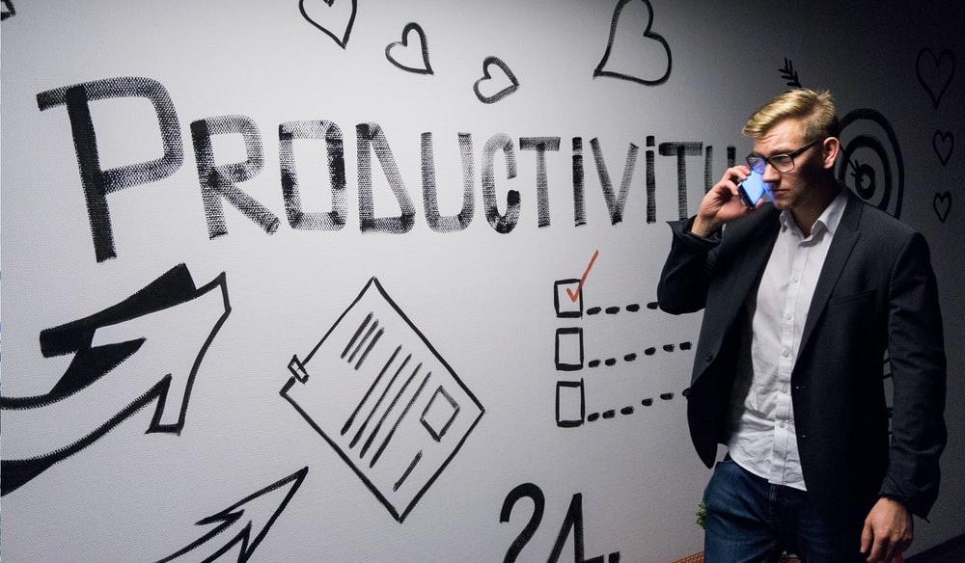
‹#›
Topic 2: Develop team cohesion
2021 Milestones International College

Slide 18
‹#›
Team cohesion is the extent to which each team members wishes to contribute to the group's ability to continue as a functioning work unit. Cohesiveness develops over time.
Cohesiveness is a product of interpersonal and group-level attraction, collaboration, and a sense of belonging.
Topic 2: Develop team cohesion
Topic 1: Insert topic title
2021 Milestones International College

Slide 19
‹#›
ACTIVITY: WATCH
Forming, Storming, Norming, Performing, Adjourning.
Video: https://www.youtube.com/watch?v=hEJaz3sinEs (08:33)
Teamwork pays off – various clips.
Video: https://www.youtube.com/watch?v=wuo13FrNX6g (01:22)
Topic 2: Develop team cohesion
2021 Milestones International College

Slide 20
‹#›
STRATEGIES TO ACHIEVE TEAM COHESION
There are many ways to achieve team cohesion. For example, promoting interaction between team members increases cohesions as team members feel more positive towards one another.
Topic 2: Develop team cohesion
Topic 1: Insert topic title
2021 Milestones International College

Slide 21
‹#›
ACTIVITY: RESEARCH AND DISCUSS
List all the factors you would consider to create better team cohesion.
Now compare your response with those of your team. Did you all have similar answers?
How did the rest of the class compare? Did their teams have the same response?
Topic 2: Develop team cohesion
2021 Milestones International College

Slide 22

‹#›
GROUP DYNAMICS
Group dynamics is a term used to describe the way in which a group of people interact with each other.
Group dynamics can impact a team’s performance, both positively and negatively.
Topic 2: Develop team cohesion
Topic 1: Insert topic title
2021 Milestones International College

Slide 23
‹#›
ACTIVITY: READ
Read the following articles about improving group dynamics and things to know about group dynamics:
https://online.maryville.edu/blog/4-things-to-know-about-group-dynamics-in-the-workplace/
https://www.mindtools.com/pages/article/improving-group-dynamics.htm
Topic 2: Develop team cohesion
2021 Milestones International College

Slide 24
‹#›
DECISION MAKING
Team leaders need to develop strategies to ensure that their team members have input into planning, decision making and operations relating to the team's work.
Topic 2: Develop team cohesion
Topic 1: Insert topic title
2021 Milestones International College

Slide 25
‹#›
ACTIVITY: RESEARCH AND DISCUSS
Work in your teams to answer the following questions.
Research The Nominal Group technique. Provide a brief overview of how it operates.
What other tools are available for decision-making? Provide a brief overview of each one you find.
Topic 2: Develop team cohesion
2021 Milestones International College

Slide 26
‹#›
TEAM COHESION FOR REMOTE TEAMS
Sometimes teams have to overcome barriers to cohesion such as remote working arrangements.
Topic 2: Develop team cohesion
Topic 1: Insert topic title
2021 Milestones International College

Slide 27
‹#›
ACTIVITY: RESEARCH AND DISCUSS
Consider teams that are located over some different areas, what online collaboration tools could be used to keep your team cohesive?
Topic 2: Develop team cohesion
2021 Milestones International College

Slide 28
‹#›
POLICIES AND PROCEDURES
Team leaders may need to develop policies and procedures at work. It is essential to understand the purpose of policy and procedures and what they include.
Topic 2: Develop team cohesion
Topic 1: Insert topic title
2021 Milestones International College

Slide 29
‹#›
CHARACTERISTICS OF ACCEPTABLE POLICY AND PROCEDURE DOCUMENTS
Features of effective policy and procedure include:
They address all aspects of operations.
They reflect the culture, value and objectives of the organisation.
They relate to logical business functions.
They are easy to understand and follow.
Topic 2: Develop team cohesion
Topic 1: Insert topic title
2021 Milestones International College

Slide 30
‹#›
ACTIVITY: WATCH
Watch the following video about writing good policy and procedures. The video provides a range of useful key and introductory information such as what should be included within a policy and procedure and communicating policy and procedures to staff.
Video: https://www.youtube.com/watch?v=BjrpvUOeHqI (07:07)
Topic 2: Develop team cohesion
2021 Milestones International College

Slide 31
‹#›
ACTIVITY: RESEARCH AND DISCUSS
Work in pairs for this activity and then present your findings to the trainer/assessor and the group. There are many diversity policies on the Internet that can be researched and used for this activity.
Topic 2: Develop team cohesion
2021 Milestones International College

Slide 32
‹#›
ACTIVITY: GROUP WORK
Work in your teams to undertake the following:
Create an Internet Usage Policy.
Create a procedure for sending emails to clients.
Topic 2: Develop team cohesion
2021 Milestones International College

Slide 33
‹#›
TEAM FEEDBACK
It is vital to give feedback to the team.
Feedback can support groups to maximise their performance and enhance their professional development and growth.
Topic 2: Develop team cohesion
Topic 1: Insert topic title
2021 Milestones International College

Slide 34
‹#›
ACTIVITY: WATCH
It's Big Keith's appraisal, what will office manager David Brent make of his strengths and weaknesses?
Video: https://www.youtube.com/watch?v=IkYUDQCYGHA (02:57)
Awkward Performance Review.
Video: https://www.youtube.com/watch?v=gdp4sPviV74 (02:38)
Topic 2: Develop team cohesion
2021 Milestones International College

Slide 35
‹#›
ACTIVITY: RESEARCH AND DISCUSS
Consider how your team have performed so far. How could you provide feedback to each team member?
Create a format that you could use to create feedback for each team member.
Topic 2: Develop team cohesion
2021 Milestones International College

Slide 36
‹#›
ISSUES AND CONCERNS
Addressing issues and concerns within teams can involve team meetings, forums, problem-solving process and grievance procedures to solve issues.
Topic 2: Develop team cohesion
Topic 1: Insert topic title
2021 Milestones International College

Slide 37
‹#›
ACTIVITY: RESEARCH
There are many models available to support the problem-solving process. Use the Internet to search for a problem-solving approach that you could use to address the concerns you have with your team.
Complete this activity in small groups and then report back to the whole group in the form of a short presentation.
Topic 2: Develop team cohesion
2021 Milestones International College

Slide 38
‹#›
ACTIVITY: GROUP WORK
One of the team members who work remotely has complained that they are not receiving the necessary information on time. Due to the delays in obtaining the information, this person is unable to meet their KPI's, and it is beginning to affect the entire team's performance.
Topic 2: Develop team cohesion
2021 Milestones International College

Slide 39

‹#›
Topic 3: Facilitate teamwork and liaise with stakeholders
2021 Milestones International College

Slide 40
‹#›
The success of a business depends on the contributions of every member of the team.
However, some teams work together better than others.
There is a sense of personal ownership of all activities, believing that their contributions are valued and feeling that work is equally shared.
Topic 3: Facilitate teamwork and liaise with stakeholders
Topic 1: Insert topic title
2021 Milestones International College

Slide 41
‹#›
ACTIVITY: WATCH
Watch the video on being a role model.
Video: https://www.youtube.com/watch?v=jIch3rpD7Zo (01:41)
Topic 3: Facilitate teamwork and liaise with stakeholders
2021 Milestones International College

Slide 42
‹#›
ENCOURAGING TEAM MEMBERS TO PARTICIPATE
A team leader or manager can use several strategies to encourage team members to participate. For example:
Encouraging ownership
Making everyone a leader
Setting a good example
Giving everyone the chance to input into decisions.
Topic 3: Facilitate teamwork and liaise with stakeholders
Topic 1: Insert topic title
2021 Milestones International College

Slide 43
‹#›
ACTIVITY: READ
Read more about encouraging team members to participate at:
https://work.chron.com/effective-techniques-encourage-team-members-contribute-project-5121.html
Take any notes to summarise what you have read and keep for future reference.
Topic 3: Facilitate teamwork and liaise with stakeholders
2021 Milestones International College

Slide 44
‹#›
COMPETENCIES
Competencies refer to the collective knowledge, skills, experience, and attributes of teams required to perform work successfully.
Team members’ roles must be defined in terms of the types of attitude, behaviours and skills the organisation values and requires to achieve its objectives.
Topic 3: Facilitate teamwork and liaise with stakeholders
Topic 1: Insert topic title
2021 Milestones International College

Slide 45
‹#›
MONITORING PERFORMANCE
Monitoring work performance will help identify how a team is managing. It helps to keep track of what's going on and allows for modification of work activities or roles.
Topic 3: Facilitate teamwork and liaise with stakeholders
Topic 1: Insert topic title
2021 Milestones International College

Slide 46
‹#›
OPEN COMMUNICATION PROCESSES
It is essential to have a good communication process to communicate with all stakeholders, whether that is the team, others in the organisation or even customers or suppliers.
Topic 3: Facilitate teamwork and liaise with stakeholders
Topic 1: Insert topic title
2021 Milestones International College

Slide 47
‹#›
MANAGEMENT COMMUNICATION
This can be verbal or written communication to the team leader or members of the team.
Effective interpersonal communication processes are essential to the establishment and maintenance of effective teams.
Topic 3: Facilitate teamwork and liaise with stakeholders
Topic 1: Insert topic title
2021 Milestones International College

Slide 48
‹#›
ACTIVITY: WATCH
Watch these video about open communication and communications and leadership.
Video: https://www.youtube.com/watch?v=hniJfc2FqPQ (03:01)
Video: https://www.youtube.com/watch?v=bRXLTZMvy-U (05:48)
Topic 3: Facilitate teamwork and liaise with stakeholders
2021 Milestones International College

Slide 49
‹#›
CONFLICT
Organisational procedures, systems, policies, codes of conduct, documentation and processes ensure that correct steps are taken if a conflict arises.
Managers must try to resolve any issues, but unresolved issues must also be addressed so that team morale and work activities can continue.
Topic 3: Facilitate teamwork and liaise with stakeholders
Topic 1: Insert topic title
2021 Milestones International College

Slide 50
‹#›
ACTIVITY: RESEARCH AND DISCUSS
In the group teams, search on the Internet for conflict resolution strategies. Brainstorm with the team to create a comprehensive list to help resolve problems within the team.
Topic 3: Facilitate teamwork and liaise with stakeholders
2021 Milestones International College

Slide 51
‹#›
ADDRESS UNRESOLVED PROBLEMS
Conflicts are not bad if they are resolved quickly and as effectively as possible.
Resolving conflicts can have negative or positive outcomes.
The gist of addressing any conflict is to hope that ideas, opinions and thoughts are discussed as openly or honestly as possible as long as it is done with respect and integrity.
Topic 3: Facilitate teamwork and liaise with stakeholders
Topic 1: Insert topic title
2021 Milestones International College

Slide 52
‹#›
ACTIVITY: READ
Conflict Resolution, Using the "Interest-Based Relational" Approach:
http://www.mindtools.com/pages/article/newLDR_81.htm
3 Techniques for Building Consensus:
https://www.leadstrat.com/3-techniques-for-building-consensus-2/
Take any notes to summarise what you have read and keep for future reference.
Topic 3: Facilitate teamwork and liaise with stakeholders
2021 Milestones International College

Slide 53
‹#›
ACTIVITY: BRAINSTORM
Brainstorm the process, strategies and workplace situation you learnt in this unit. Use the information to complete the table to demonstrate your understanding of how you will manage team effectiveness. For each task identify which business policies and procedures or relevant document you will use. Also, determine three strategies of how you will manage the task.
Topic 3: Facilitate teamwork and liaise with stakeholders
2021 Milestones International College

